Slide 1
DC Summer Term 2023
Hardware Design Description Analysis
Rahul Barodia ( B20CS047 )

Slide 2
TimeLine
Code5
Parsed Output from relations
Starter_code
Code3
Code2
Code4
Code6

Slide 3
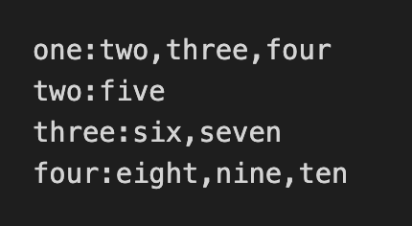
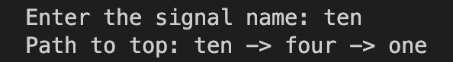
Task
The parsed output :
Backward Traversal :

Slide 4

Starter Code

Slide 5
Trees
One
Enter the signal name : Seven
Output : Seven -> Three -> One
Two
Three
Four
Five
Six
Seven

Slide 6
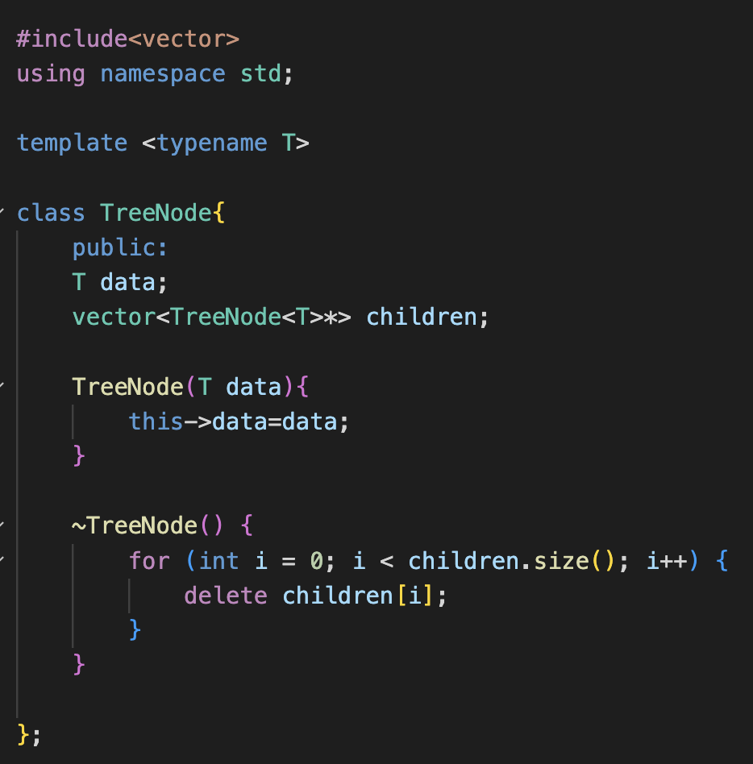
Tree Data structure

Slide 7
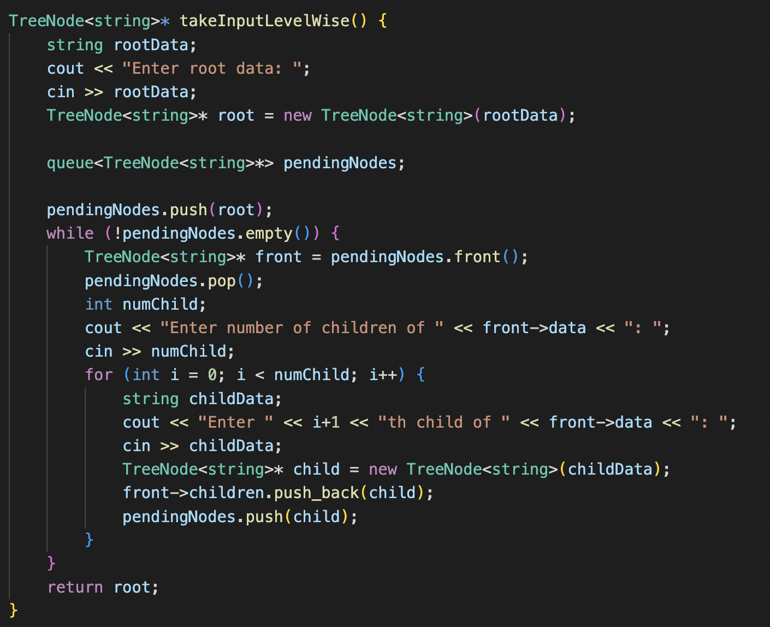
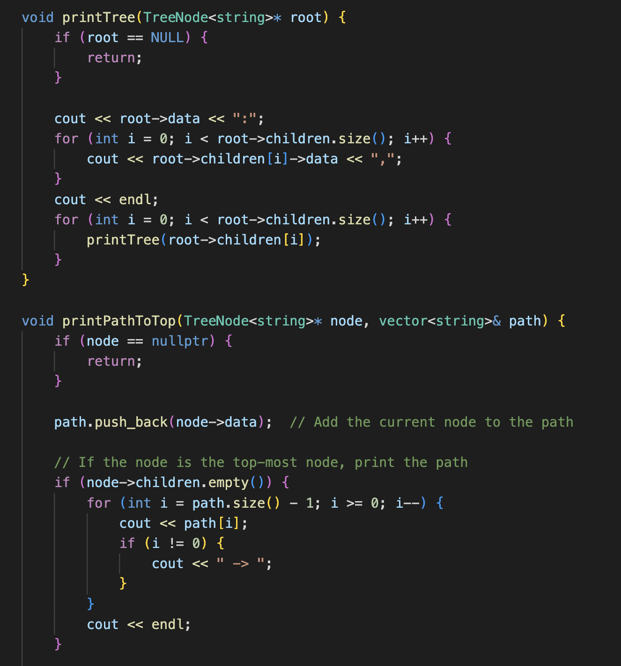
https://github.com/Rahul28428/Backward-Traversal/blob/main/Starter_code.cpp

Slide 8
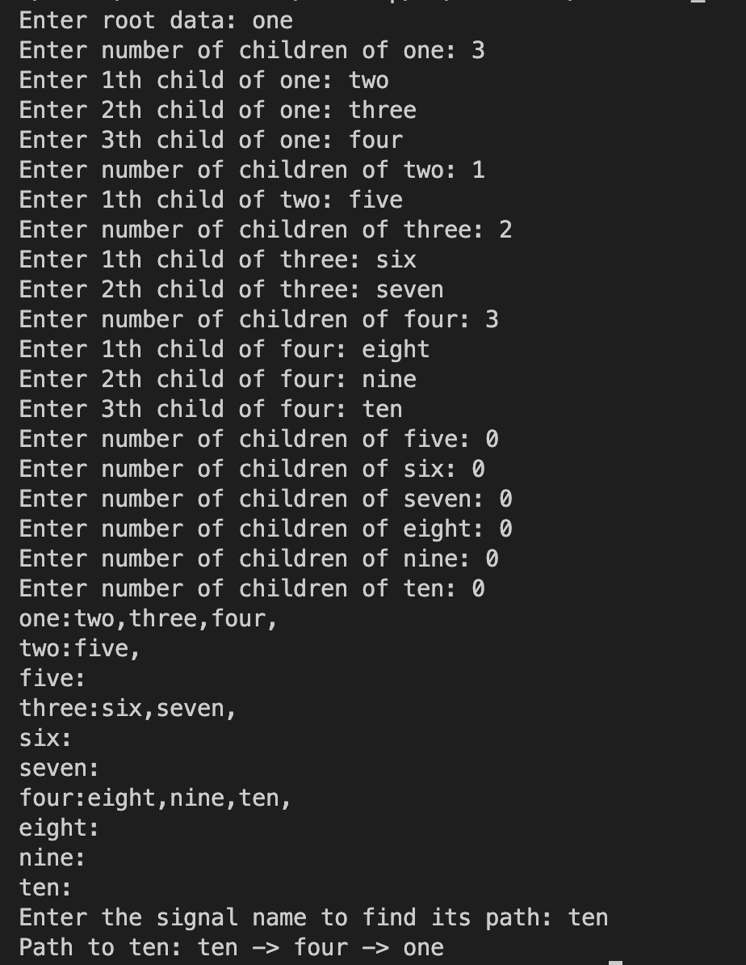
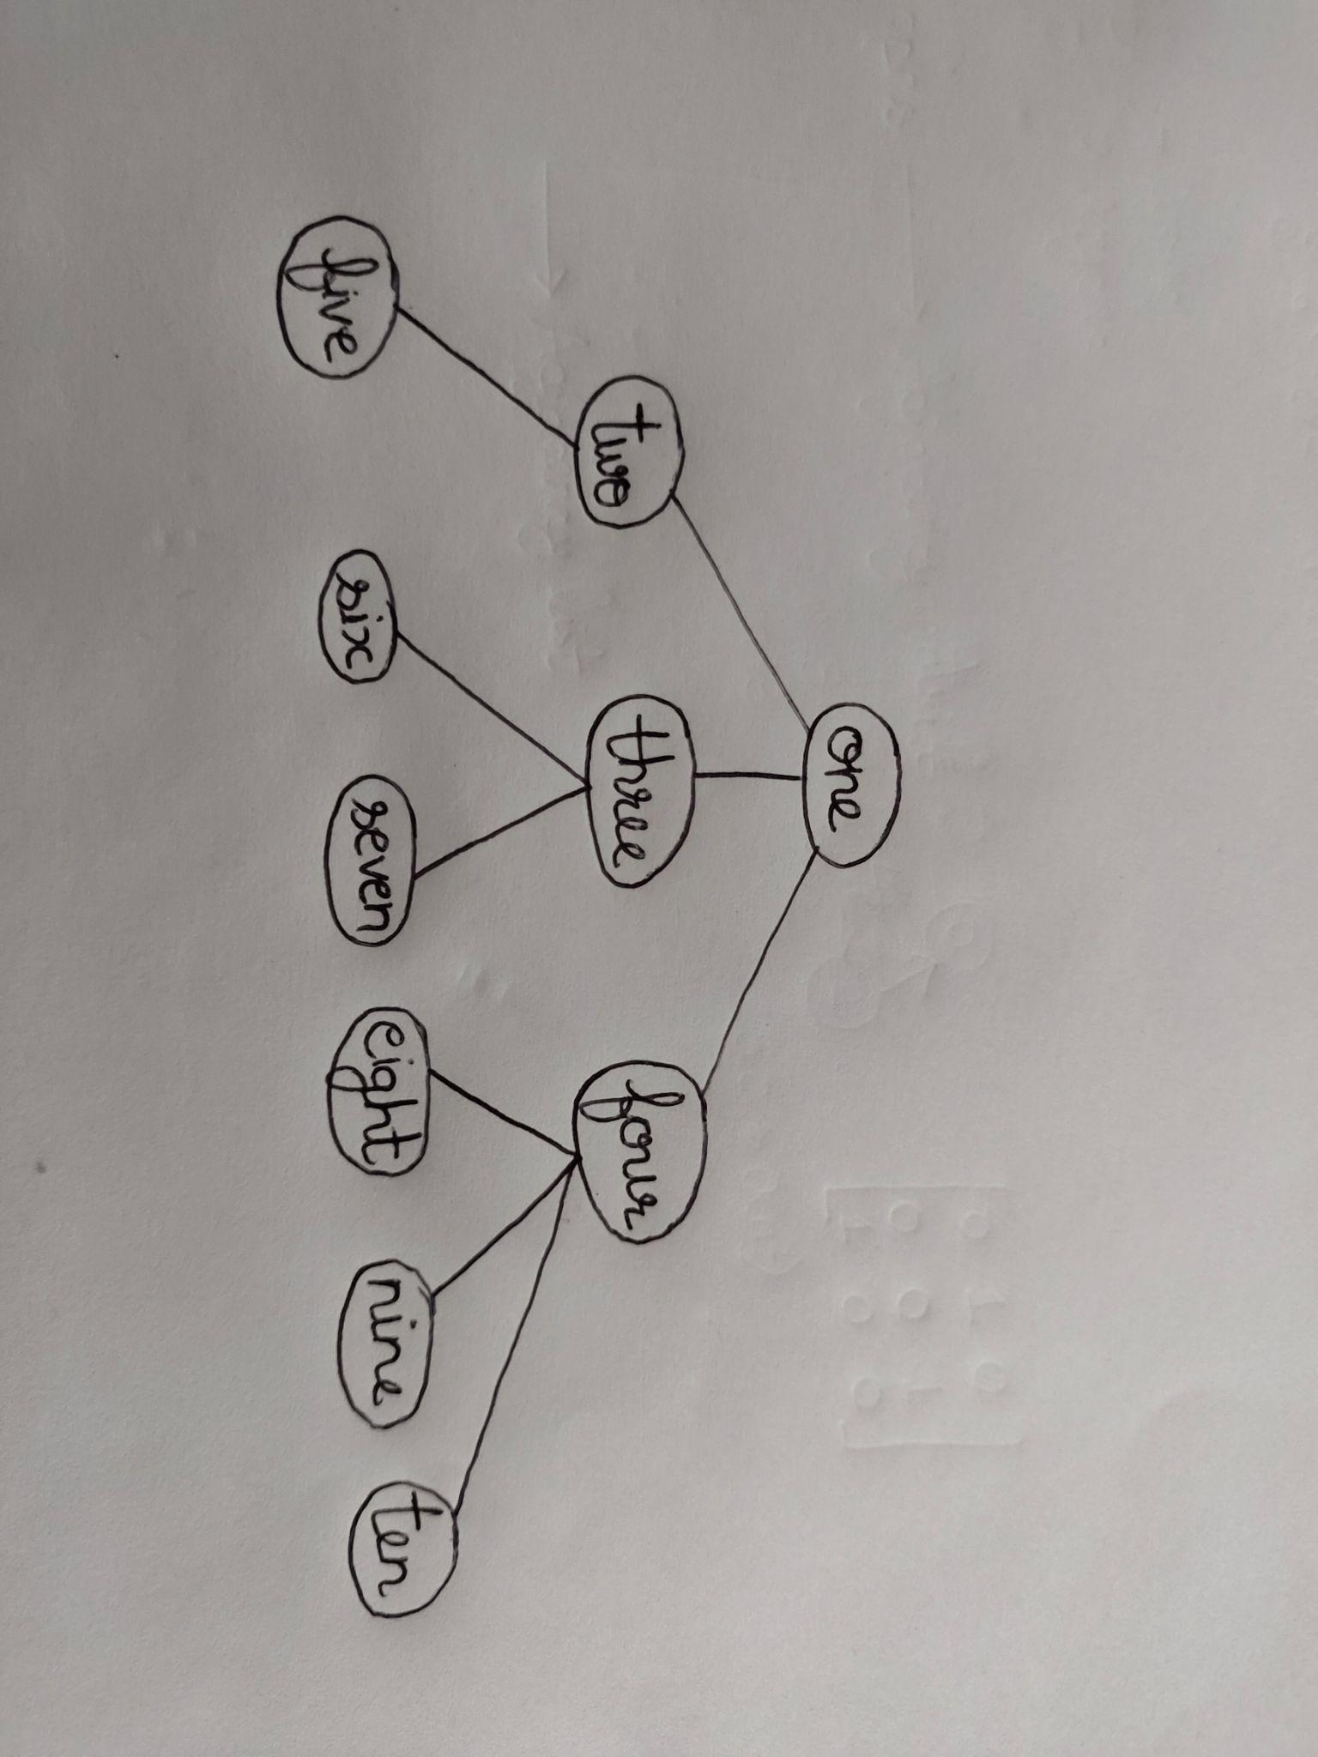
The parsed output :

Slide 9
Code 2
Inserting parsed output directly into the code in hardcoded form

Slide 10
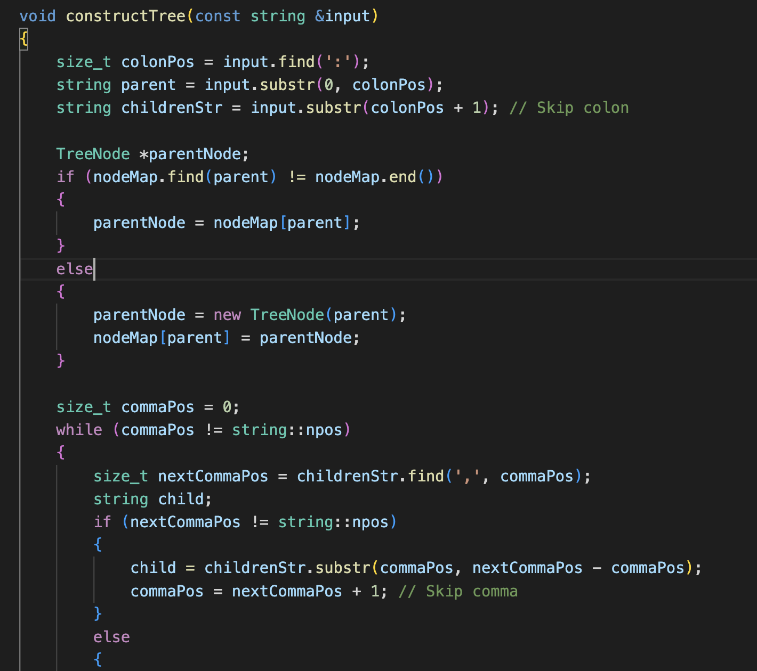
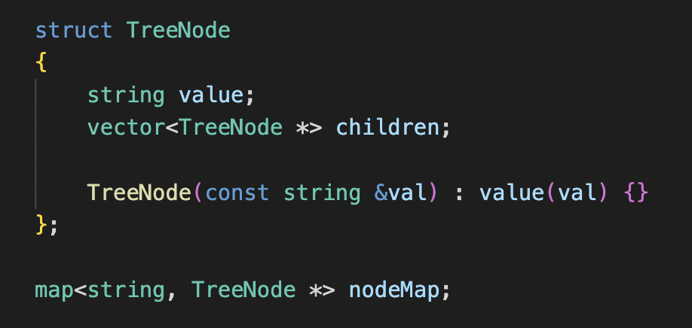
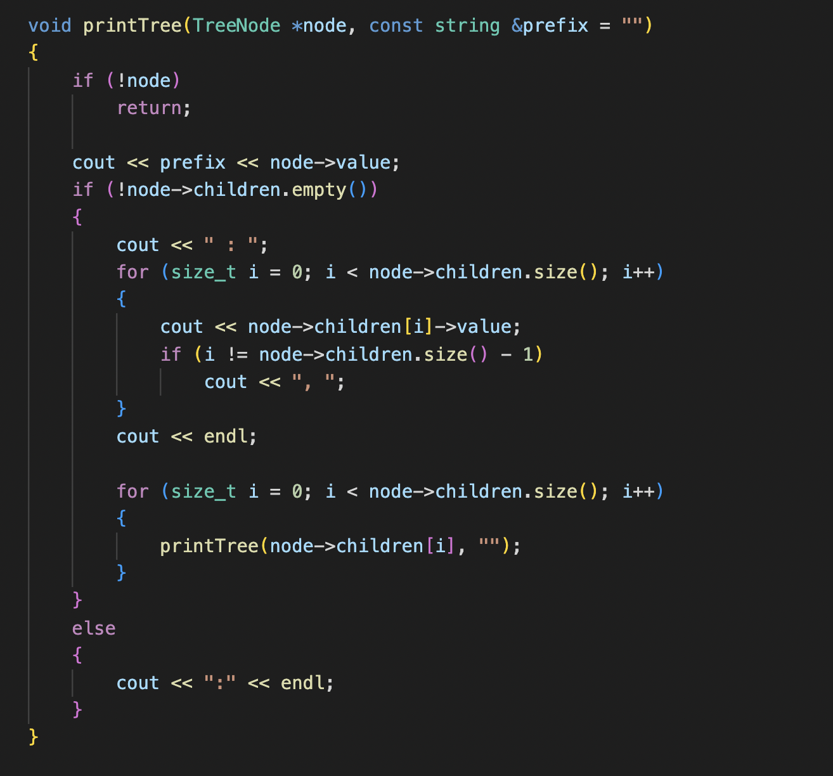
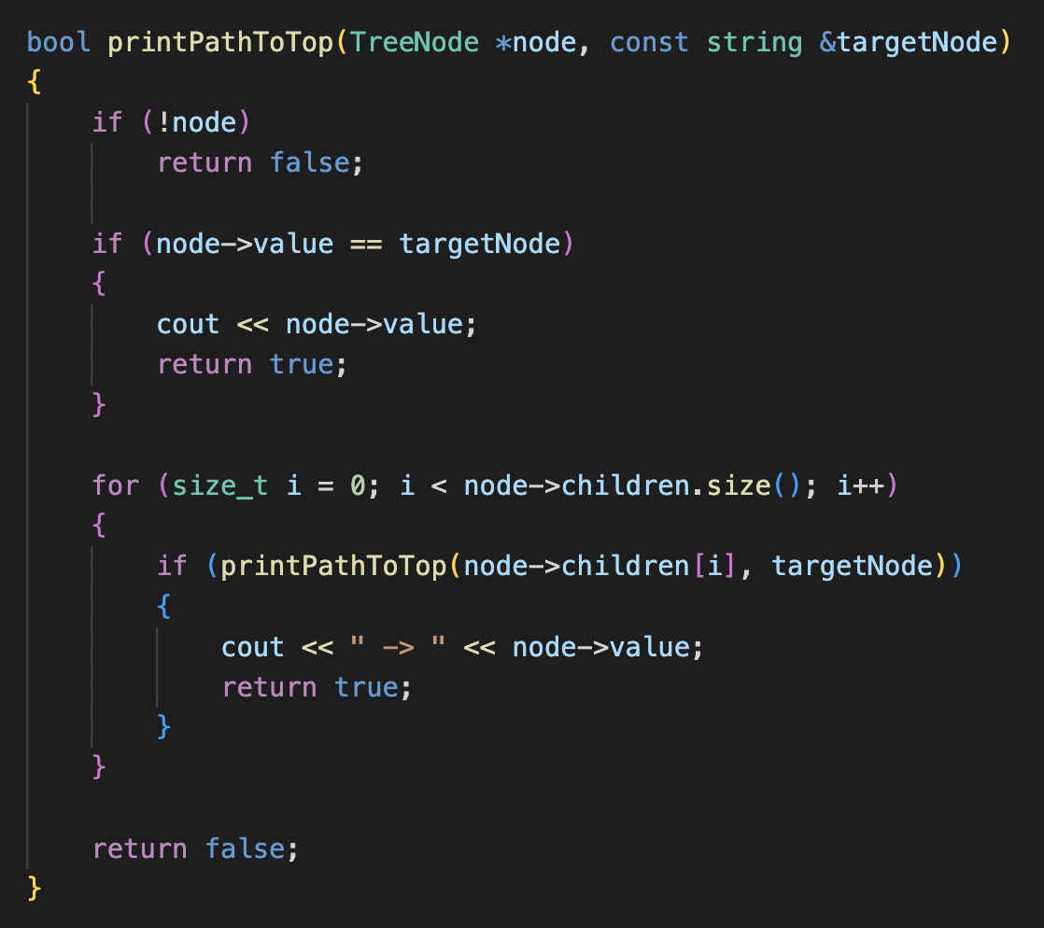

Slide 11
Logic of constructTree
The constructTree function takes an input string representing a parent-child relationship and constructs a tree structure using TreeNode objects.
It finds the position of the colon character in the input string to separate the parent and children parts. It then creates or retrieves the parent TreeNode object from the nodeMap based on the parent string.
Next, it iterates through the children part, extracting each child string delimited by commas. For each child, it creates or retrieves the corresponding TreeNode object and adds it to the parent's children vector.
Overall, the function builds a tree structure by creating TreeNode objects for parents and their children, connecting them appropriately based
on the input string.

Slide 12
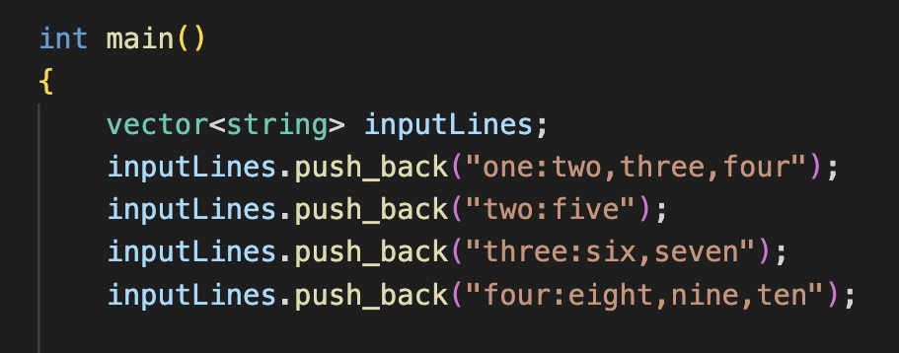
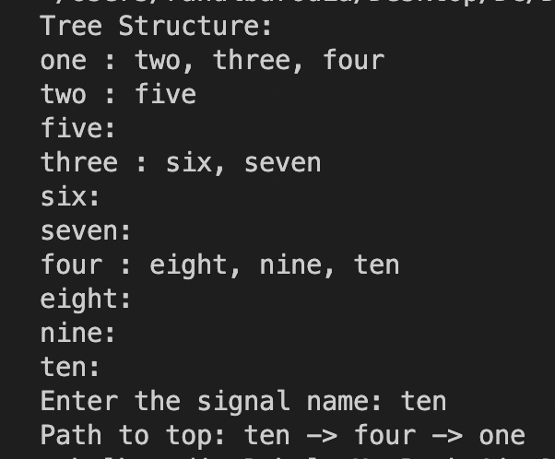
https://github.com/Rahul28428/Backward-Traversal/blob/main/Code2.cpp

Slide 13
Code 3
Extracting parsed output from a text file and then feeding it to the code

Slide 14
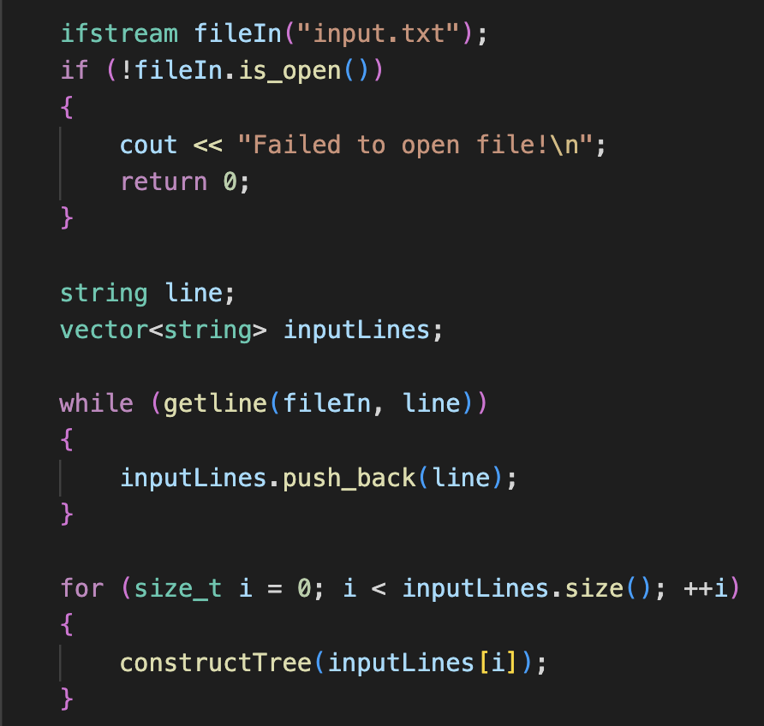
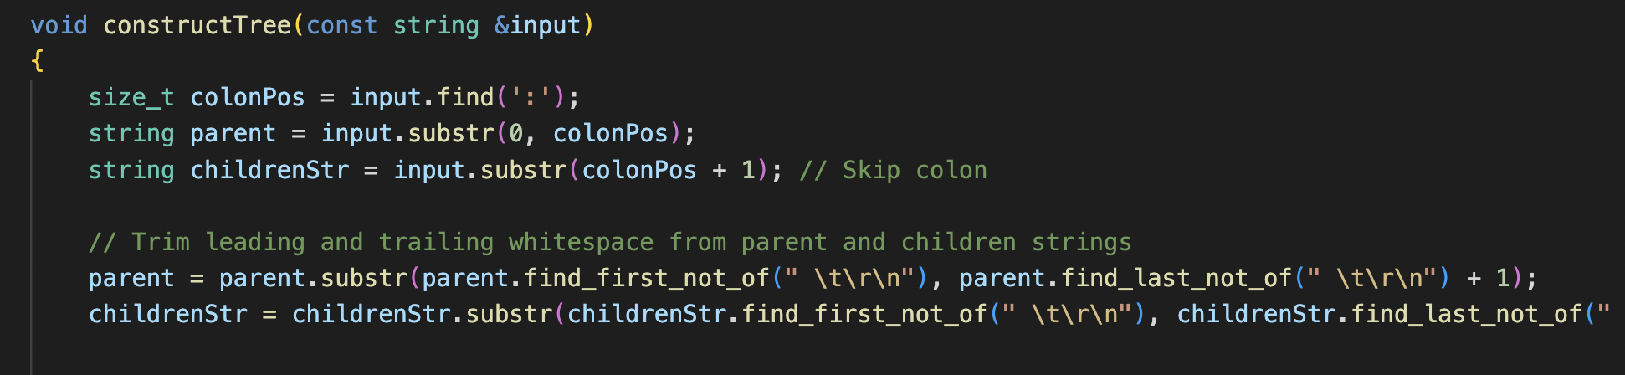
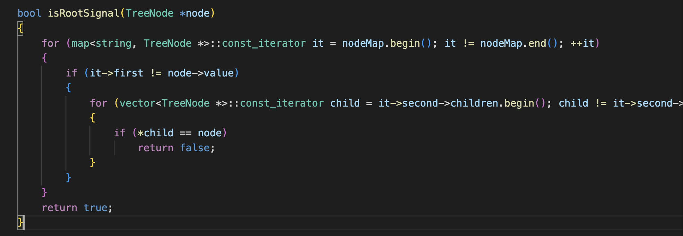

Slide 15
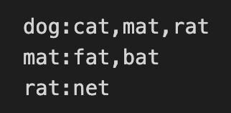
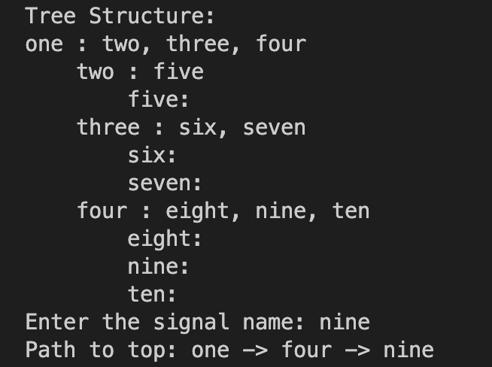
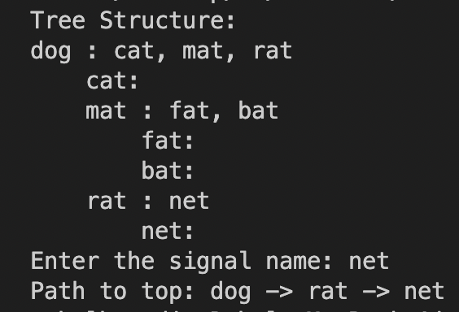
Input.txt
Input2.txt
Code3

Slide 16
Code 4
Optimizing Code 3

Slide 17
Use const references for function parameters: In some functions like printTree and printPathToTop, pass the tree nodes as const TreeNode* or const TreeNode& to avoid unnecessary copies of the nodes.
Improve data structures and algorithms: Depending on the specific requirements of your application, you may consider using more efficient data structures and algorithms. For example, using a hash-based data structure like std::unordered_map instead of std::map can provide faster lookup times.

Slide 18
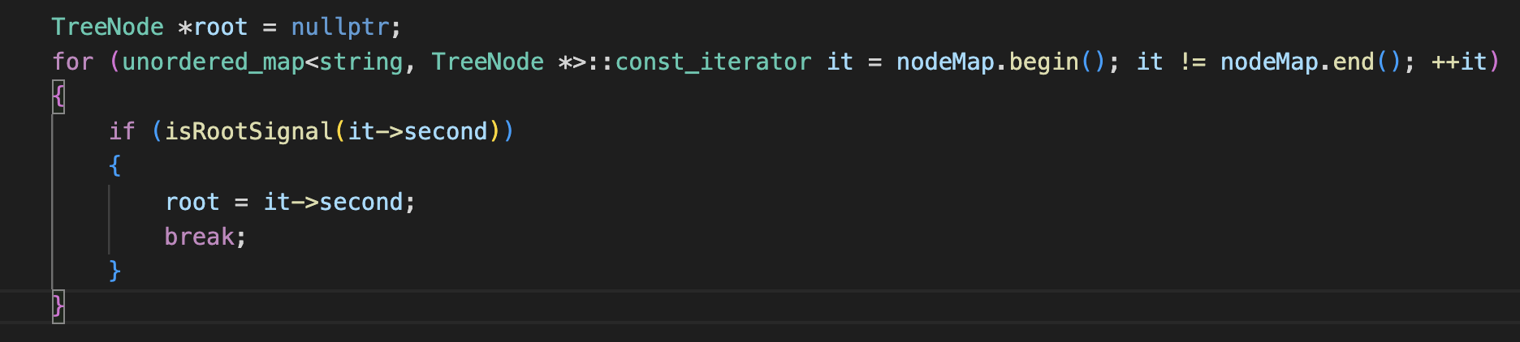
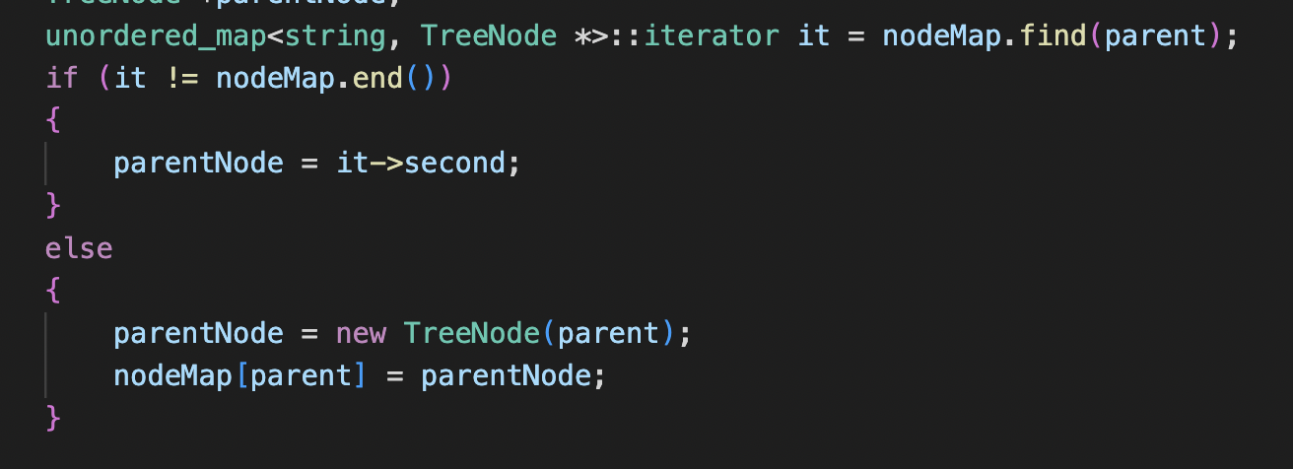
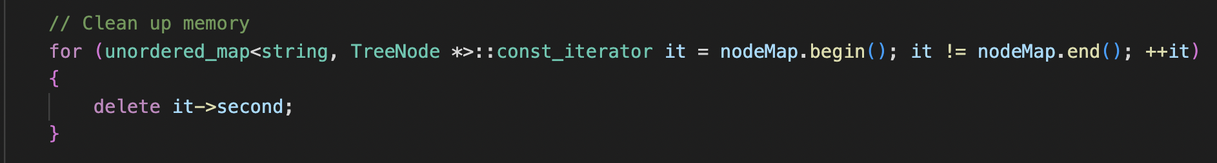
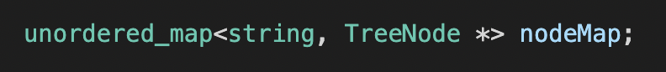
Code4.cpp

Slide 19
Code 5
Using unordered_map inplace of Tree

Slide 20
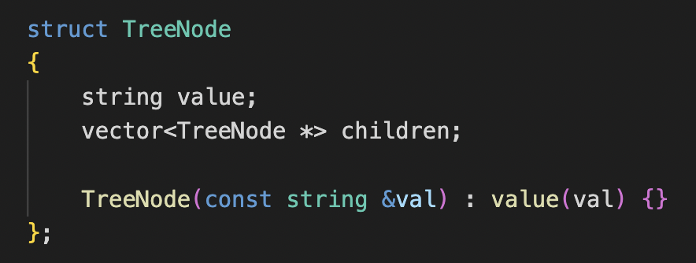
Code5 uses an unordered map nodeMap with string keys and a pair of string and vector<string> as the value type. Whereas Code4 uses an unordered map nodeMap with string keys and TreeNode* as the value type. The tree nodes are represented using a custom TreeNode struct.

Slide 21
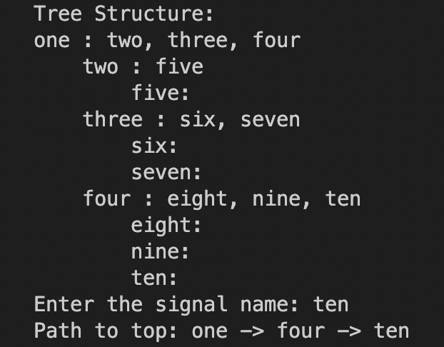
Code5.cpp

Slide 22
Code 6
Making a new struct

Slide 23
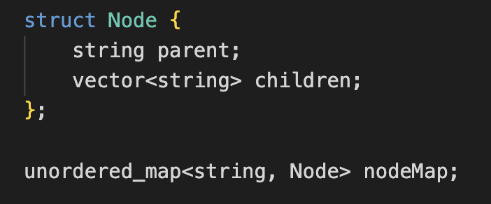
Explanation :
The tree structure is represented using a custom struct called Node.
The nodeMap is an unordered_map with string keys and Node values. It stores the parent node as a string and the children nodes as a vector of strings.
The constructTree function creates and populates the nodeMap by parsing the input string and storing the parent and children nodes in the Node structure.

Slide 24
Code6.cpp

Slide 25
Parsed output from relations

Slide 26
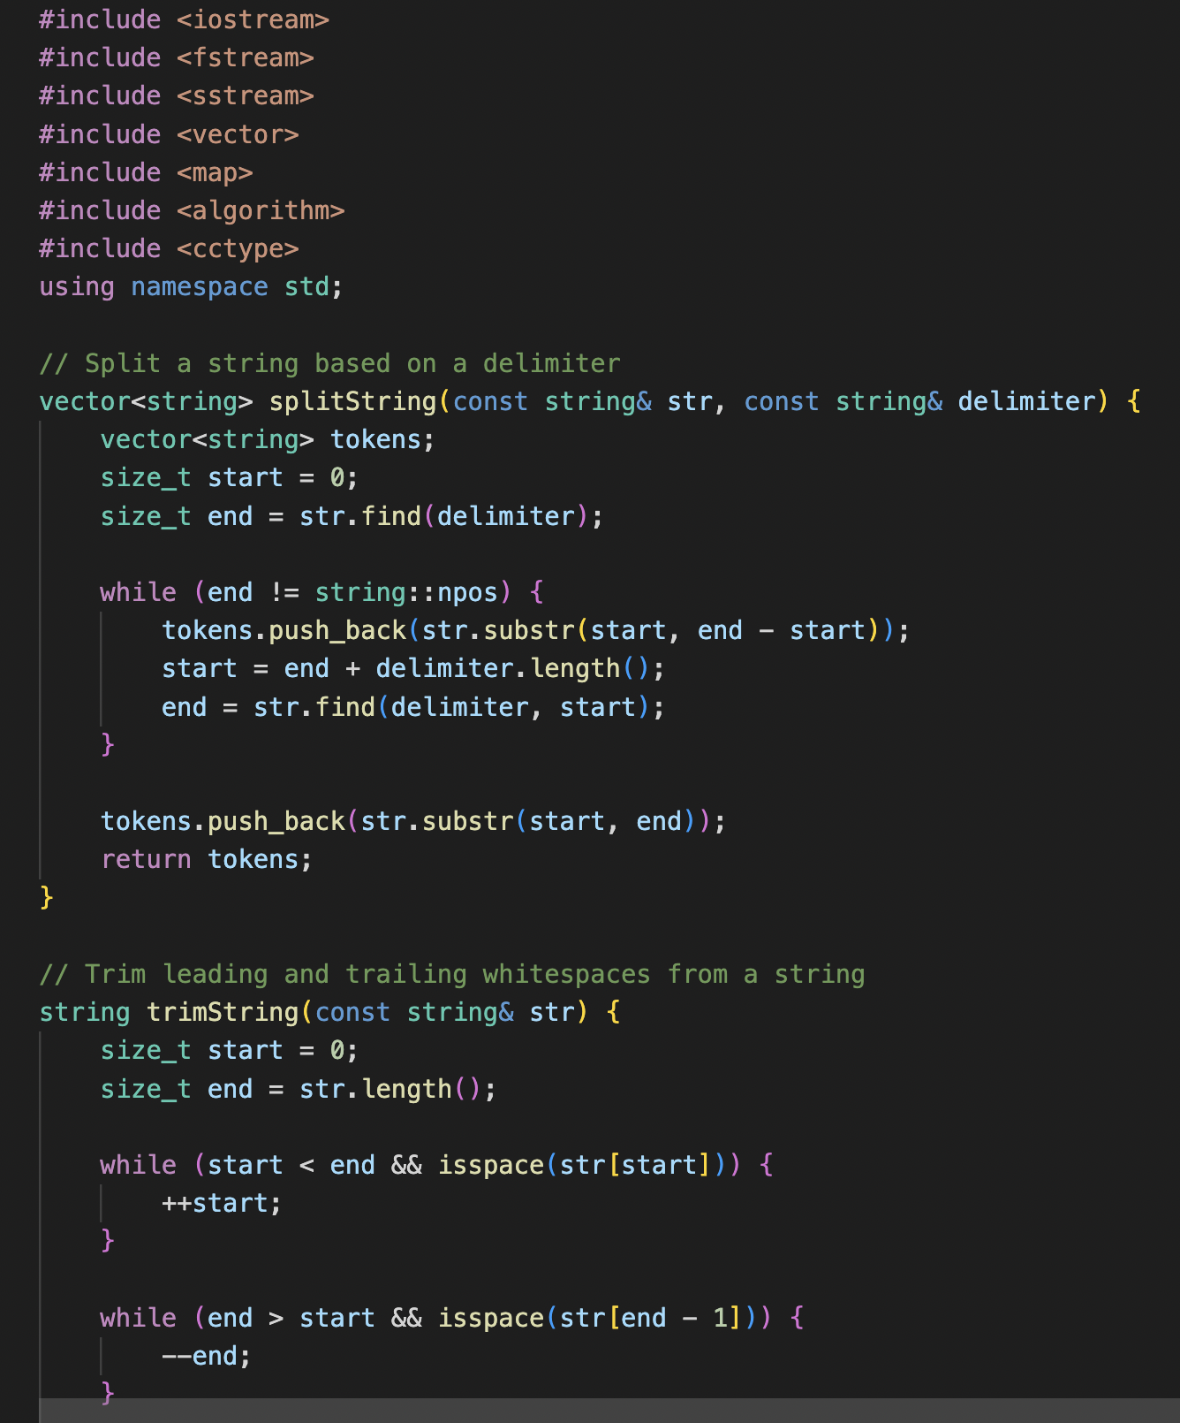
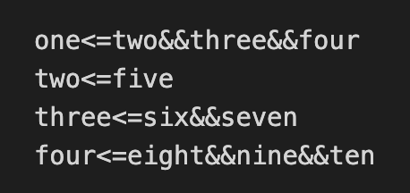
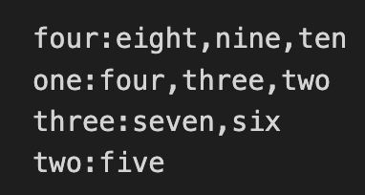
Convert.cpp
Input_pre.txt
Input_post.txt

Slide 27
Thanks!

